Slide 1


DEFFORESTATION DETECTION
[Fire Classification]
Gaurav Singh Pundir
AICTE ID:-STU684838525aff41749563474
AICTE INTERNSHIP ID: INTERNSHIP_175040797468551b2636342

Slide 2

Learning Objectives
To analyze MODIS datasets from multiple years (2021–2023).
To apply Machine Learning techniques for classifying fire occurrences.
To perform data preprocessing, feature selection, and model building.
To compare classification models and evaluate performance.
To propose an effective solution for fire detection and Classification .
GOAL
Source :
www.freepik.com/

Slide 3
Tools and Technology used
# Programming Language:
Python: Core language for data processing, model training, and Streamlit UI development.
# Libraries:
Pandas, NumPy: Data manipulation and analysis.
Scikit-learn: Machine learning models and preprocessing.
TensorFlow: Neural network implementation.
XGBoost: Gradient boosting for classification.
Imbalanced-learn: SMOTE for handling class imbalance.
Streamlit: Interactive web-based UI for model deployment.
# ML Techniques:
Logistic Regression, Decision Tree, Random Forest, K-Neighbors Classifier, Neural Network.
SMOTE: Oversampling to address class imbalance.
StandardScaler: Feature scaling for model optimization.

Slide 4
Tools and Technology used
# Environment:
Google Colab: Cloud-based Jupyter notebook for model development and training.
Streamlit Cloud: Deployment platform for the web-based UI.
# Visualization:
Matplotlib, Seaborn: Count plots, histograms, scatter plots, and correlation heatmaps.
Streamlit: Real-time interactive visualizations in the UI.

Slide 5
Methodology
# Data Collection:
Sourced from MODIS dataset (2021–2023) for forest fires in India.
Features include latitude, longitude, brightness, confidence, and fire type.
Data stored in CSV format for processing.
# Data Preprocessing:
Handled missing values and outliers in the dataset.
Applied StandardScaler for feature scaling to normalize data.
Used SMOTE (Synthetic Minority Oversampling Technique) to address class imbalance in fire type classification.
# Exploratory Data Analysis (EDA):
Analyzed feature distributions using histograms and count plots.
Visualized spatial patterns with scatter plots of latitude and longitude.
Generated correlation heatmap to identify relationships between features.

Slide 6
Methodology
# Model Building:
Implemented multiple models: Logistic Regression, Decision Tree, Random Forest, K-Neighbors Classifier, and Neural Network (using TensorFlow).
Utilized XGBoost for gradient boosting-based classification.
Split data into training and testing sets for model training.
# Model Evaluation:
Evaluated models using accuracy, precision, recall, and F1-score.
Random Forest achieved highest accuracy (0.9695).
Visualized model performance with confusion matrices and classification reports.

Slide 7
Problem Statement:
Fires, whether in forests, grasslands, or human settlements, pose serious threats to life, property, and the environment.
They can spread rapidly, causing loss of biodiversity, economic damage, and severe air pollution.
Traditional fire monitoring methods are often slow and resource-intensive. With MODIS satellite data, it is possible to build a machine learning-based fire classification system that can process large-scale, multi-year data, handle class imbalance, and accurately detect and classify fire occurrences to enable quicker emergency response and hazard management.

Slide 8
Developed a Machine Learning classification pipeline to identify forest fire occurrences.
Solution:
# Satellite Data Source: Data was collected from MODIS (Moderate Resolution Imaging Spectroradiometer) on Terra and ` Aqua satellites for India, covering 2021, 2022, and 2023.
# Dataset Details:
Total records after merging: 271,217 rows and 15 features.
No missing or duplicate values.
Target variable( type ) class imbalance:
Class 0: 257,625 samples
Class 2: 13,550 samples
Class 3: 42 samples

Slide 9
Developed a Machine Learning classification pipeline to identify forest fire occurrences.
Solution:
# Handling Class Imbalance:
Applied SMOTE (Synthetic Minority Oversampling Technique) to create a balanced dataset across classes.
Post-SMOTE distribution: Class 0, 2, and 3 each had 257,625 samples.
# Model Selection:
Trained multiple algorithms: Logistic Regression, Decision Tree, Random Forest, KNN, and Neural Network.
Random Forest Classifier was chosen as the final model due to highest accuracy.
# Random Forest Performance:
Accuracy Score: 96.95%
Precision, recall, and F1-score for all classes were above 0.95, with perfect performance for Class 3.

Slide 10
Developed a Machine Learning classification pipeline to identify forest fire occurrences.
Solution:
Deployment:
Saved trained Random Forest model as best_fire_detection_model.pkl.
Saved StandardScaler as scaler.pkl for consistent preprocessing during prediction.
Can be deployed as a Flask or Streamlit web app for real-time fire classification.
Possible integration with live MODIS satellite API for instant detection alerts.
GitHub Link: https://github.com/GauravSinghPundir/Forest-Fire-Classification-ML-/

Slide 11
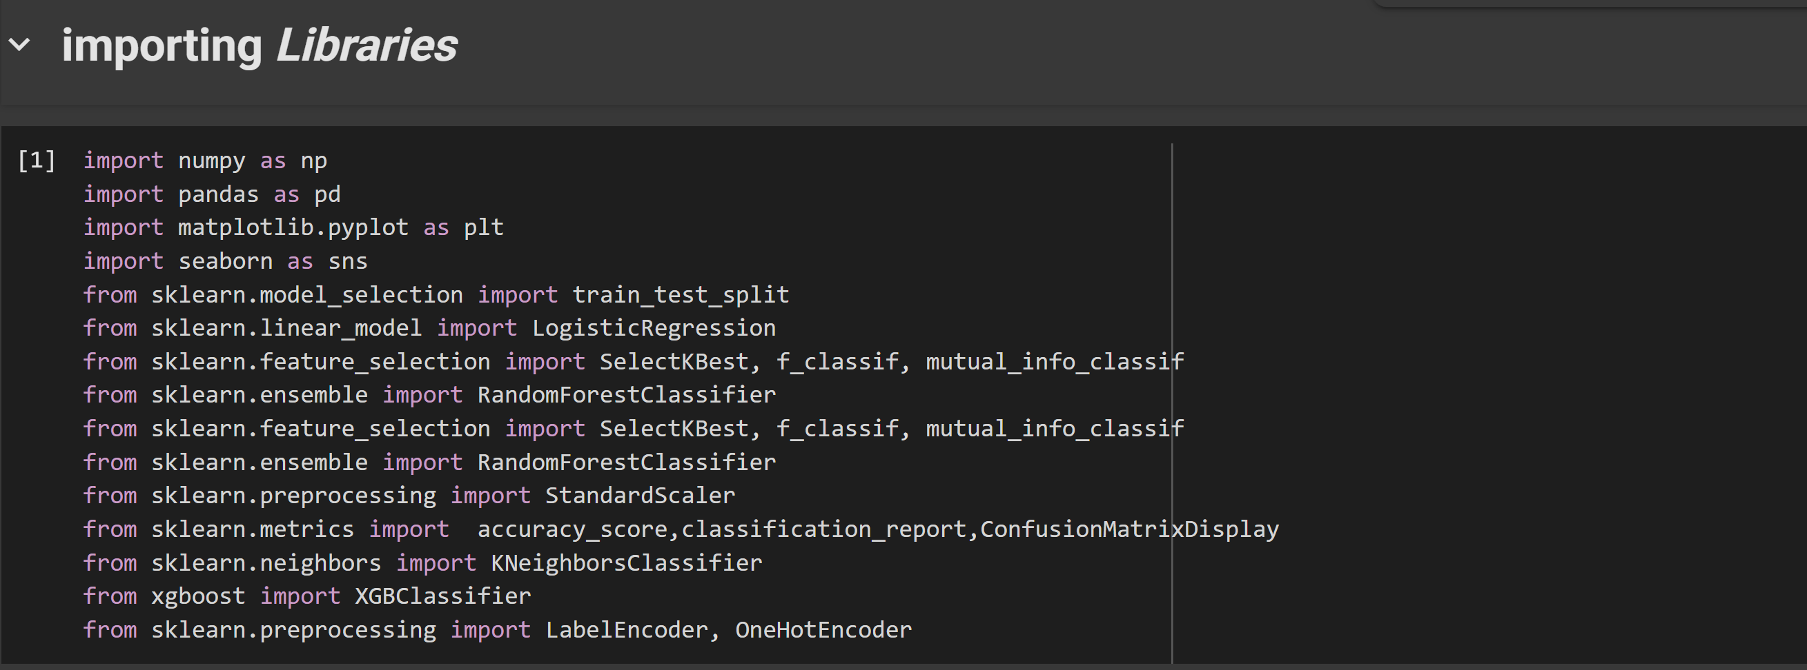
Screenshot of Output:

Slide 12
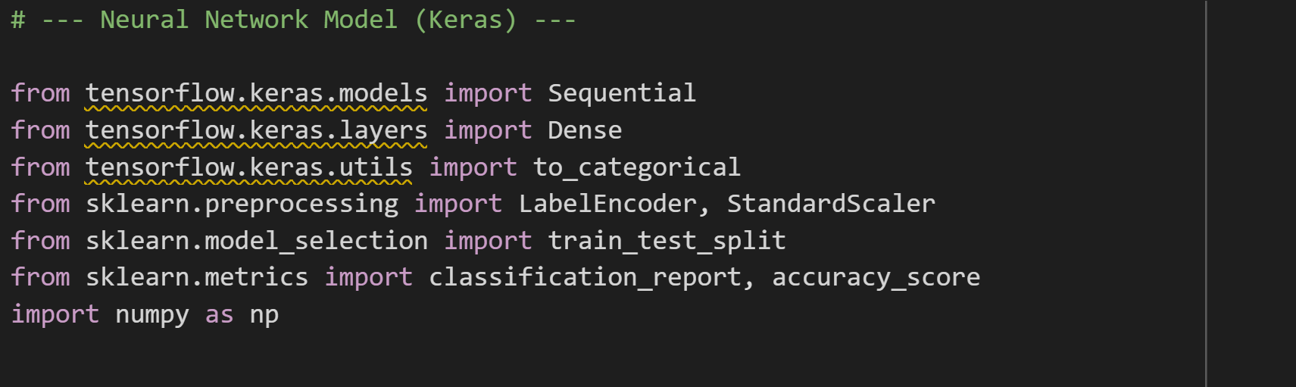
Screenshot of Output:

Slide 13
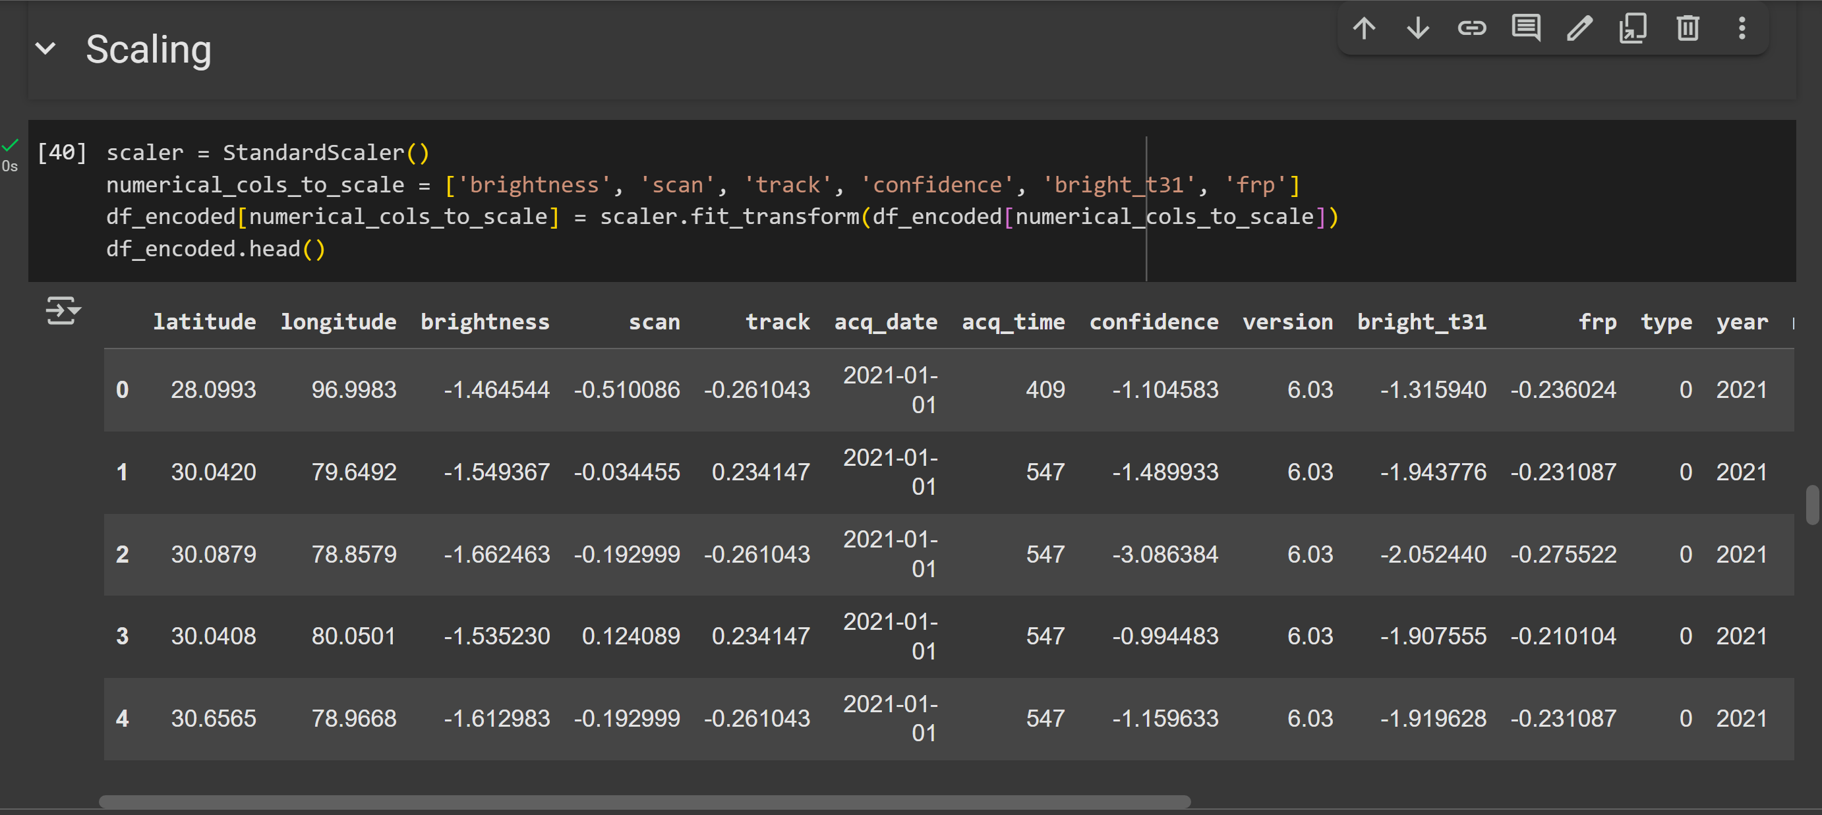
Screenshot of Output:

Slide 14
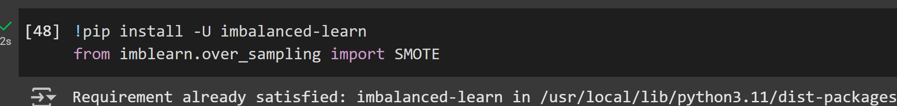
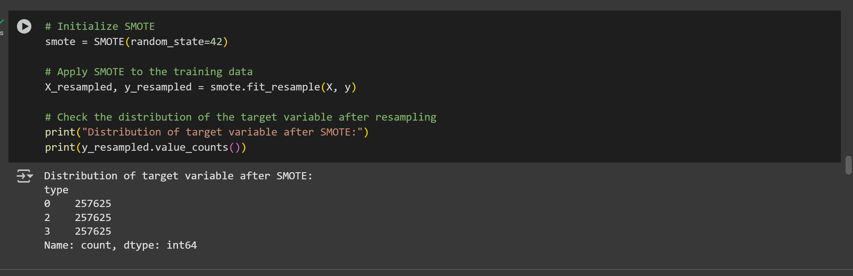
Screenshot of Output:

Slide 15
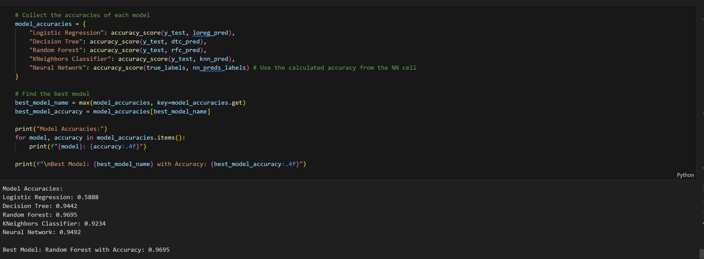
Screenshot of Output:

Slide 16
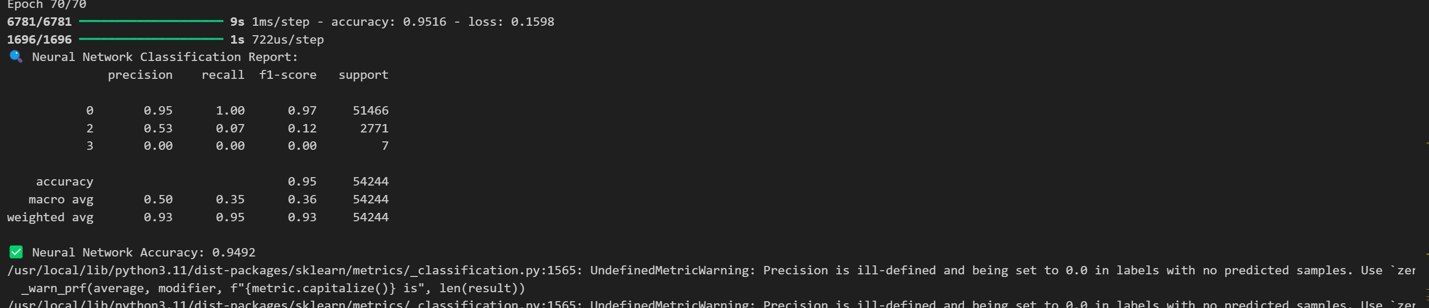
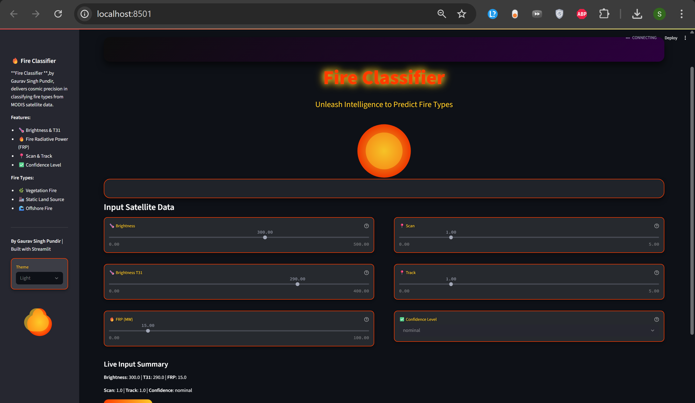
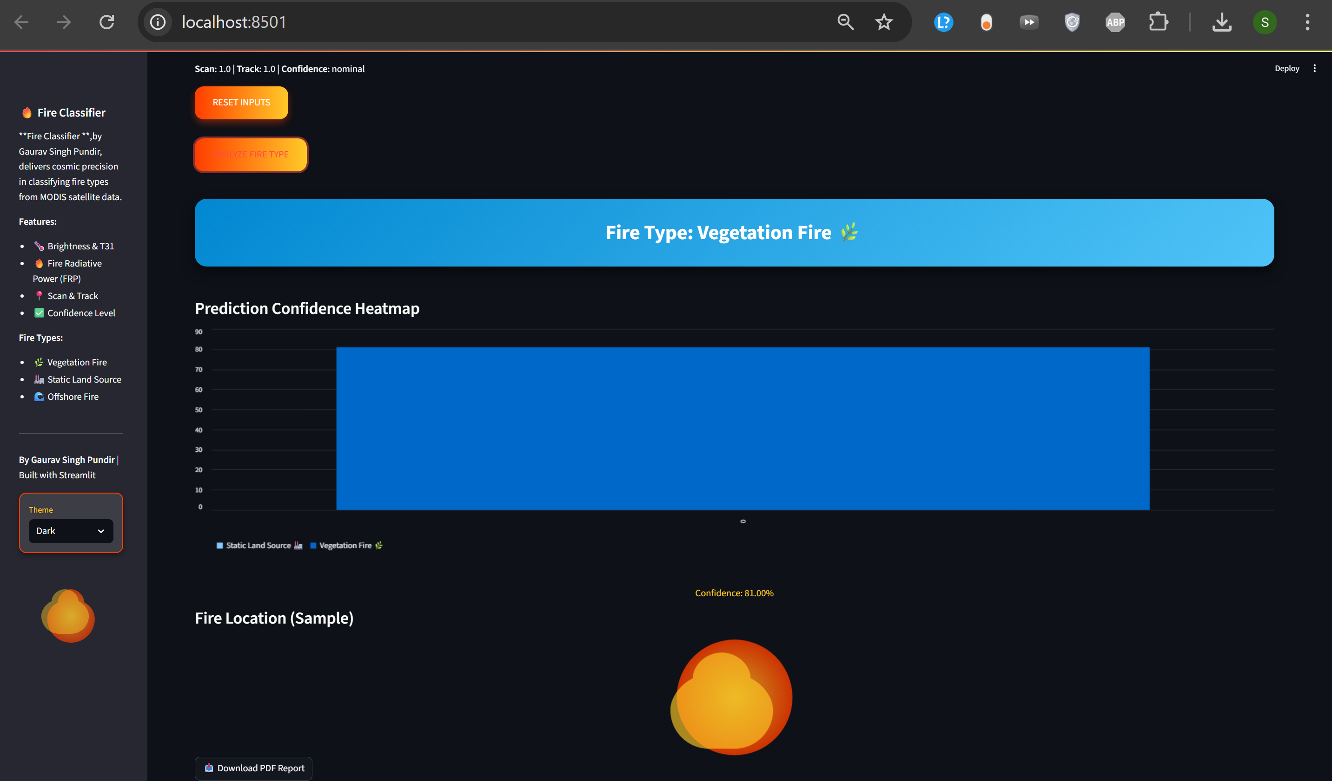
Screenshot of Output: IMPROVIZATIONS

Slide 17
Improvizations Done :
Neural Network Implementation with PyTorch
Adapted the neural network model from TensorFlow (as in the original Colab notebook) to PyTorch for enhanced flexibility and dynamic computation graph support.
Designed and trained a custom neural network architecture for forest fire classification, leveraging PyTorch’s autograd for efficient backpropagation.
Optimized model training with PyTorch’s DataLoader for batch processing and utilized GPU acceleration (if available in Colab) to improve performance.
Enhanced Streamlit UI
Developed an interactive Streamlit-based web interface for real-time forest fire prediction using the trained models.
Included input fields for key features (e.g., latitude, longitude, brightness, confidence, fire type) to allow users to input data for predictions.
Integrated real-time visualization of prediction outputs, such as fire risk probabilities or classification results, using Streamlit’s plotting capabilities.
Added functionality to generate a downloadable report (e.g., DOC or PDF) summarizing input data, prediction results, and visualizations for user convenience.
Implemented user-friendly design elements, such as sliders, dropdowns, and buttons, to enhance interactivity and accessibility.

Slide 18
# Additional UI Features :
Incorporated error handling in the UI to manage invalid inputs and provide clear feedback to users.
Enhanced the UI with dynamic updates, such as live feedback on model confidence scores and interactive maps for spatial data visualization.
Ensured cross-platform compatibility by deploying the Streamlit app on Streamlit Cloud, enabling seamless access via web browsers.

Slide 19
Conclusion:
Collected and combined MODIS fire datasets (2021–2023) for India and performed thorough preprocessing.
Conducted exploratory data analysis to understand patterns and relationships in fire occurrence.
Random Forest and XGBoost provided higher accuracy compared to Logistic Regression and KNN
Successfully built and tested ML models for forest fire classification
Machine Learning can be a powerful tool for early fire detection, helping in disaster management.
The approach can be extended with more datasets and real-time data for better prediction.
Integrate real-time satellite data to enable instant fire detection and alert systems.
Enhance model accuracy by incorporating weather, vegetation, and topographical data for better prediction.

